Slide 1
Common .NET Types
Sangeeth Sudhakaran

Slide 2
Topics to cover
Working with numbers
Working with text
Pattern matching with regular expressions
Working with spans, indexes, and ranges
Working with network resources

Slide 3
Introduction
This chapter is about some common types that are included with .NET. These include types for manipulating numbers, text, collections, improving working with spans, indexes, and ranges, and network access.

Slide 4
Type of numbers
most common types of data is numbers
Example type | Namespace | Description
SByte , Int16 , Int32 , Int64 | System | Integers; that is, zero, and positive and negative whole numbers
Byte , UInt16 , UInt32 , UInt64 | System | Cardinals; that is, zero, and positive whole numbers
Half , Single , Double | System | Reals; that is, floating-point numbers
Decimal | System | Accurate reals; that is, for use in science, engineering, or financial scenarios
BigInteger , Complex , Quaternion | System.Numeric | Arbitrarily large integers, complex numbers, and quaternion numbers

Slide 5
Working with numbers
most common types of data is numbers
The largest whole number that can be stored in .NET types that have a C# alias is about eighteen and a half quintillion, stored in an unsigned long integer
Sample program1 : maximum value of the ulong type, and a number with 30 digits using BigInteger
Console.WriteLine("Working with large integers:");
ulong big = ulong.MaxValue;
Console.WriteLine($"{big,40}");
BigInteger bigger =
BigInteger.Parse("123456789012345678901234567890");
Console.WriteLine($"{bigger,40}");
Output:
Working with large integers:
18,446,744,073,709,551,615
123,456,789,012,345,678,901,234,567,890

Slide 6
Working with complex numbers
A complex number can be expressed as a + bi, where a and b are real numbers, and i is an imaginary unit, where i2 = −1. If the real part a is zero, it is a pure imaginary number. If the imaginary part b is zero, it is a real number.
Complex numbers have practical applications in many STEM (science, technology, engineering, and mathematics) fields of study. They are added by separately adding the real and imaginary parts of the summands;
consider this: (a + bi) + (c + di) = (a + c) + (b + d)i
Sample program2 : add two complex numbers

Slide 7
Console.WriteLine("Working with complex numbers:");
Complex c1 = new(real: 4, imaginary: 2);
Complex c2 = new(real: 3, imaginary: 7);
Complex c3 = c1 + c2;
// output using default ToString implementation
Console.WriteLine($"{c1} added to {c2} is {c3}");
// output using custom format
Console.WriteLine("{0} + {1}i added to {2} + {3}i is {4} + {5}i",
c1.Real, c1.Imaginary,
c2.Real, c2.Imaginary,
c3.Real, c3.Imaginary);
Output:
Working with complex numbers:
(4, 2) added to (3, 7) is (7, 9)
4 + 2i added to 3 + 7i is 7 + 9i

Slide 8
Understanding quaternions
Quaternions are a number system that extends complex numbers. They form a four-dimensional associative normed division algebra over the real numbers, and therefore also a domain.
They are good at describing spatial rotations, so video game engines use them, as do many computer simulations and flight control systems.

Slide 9
Generating random numbers for games and similar apps
In scenarios that don't need truly random numbers like games, you can create an instance of the Random class, as shown in the following code example:
Random r = new();
Random has a constructor with a parameter for specifying a seed value used to initialize its pseudo-random number generator, as shown in the following code:
Random r = new(Seed: 46378);
Sample program3 : Usage of Random numbers

Slide 10
Random r = new();
int dieRoll = r.Next(minValue: 1, maxValue: 7); // returns 1 to 6
double randomReal = r.NextDouble(); // returns 0.0 to less than 1.0
byte[] arrayOfBytes = new byte[256];
r.NextBytes(arrayOfBytes); // 256 random bytes in an array
r.NextBytes(arrayOfBytes);
Console.WriteLine("Random int between 1 to 6 : " + dieRoll);
Console.WriteLine("Random double between 0.0 to 1.0 : " + randomReal);
Console.WriteLine("Random byte between 0 to 256 : " + arrayOfBytes[0]);
Output:
Random int between 1 to 6 : 6
Random double between 0.0 to 1.0 : 0.6222448188915126
Random byte between 0 to 256 : 59

Slide 11
Working with text
One of the other most common types of data for variables is text. The most common types in .NET for working with text are shown in the following table:
Example type | Namespace | Description
Char | System | Storage for a single text character
String | System | Storage for multiple text characters
StringBuilder | System.Text | Efficiently manipulates strings
Regex | System.Text.RegularExpressions | Efficiently pattern-matches string

Slide 12
Working with text
One of the other most common types of data for variables is text. The most common types in .NET for working with text are shown in the following table:
Let's explore some common tasks when working with text;
length of a of text
string city = "London";
WriteLine($"{city} is {city.Length} characters long.");
Output :
London is 6 characters long.

Slide 13
Characters of a string using index
The string class uses an array of char internally to store the text. It also has an indexer, which means that we can use the array syntax to read its characters. Array indexes start at zero, so the third character will be at index 2.
Sample program :
string city = "London";
WriteLine($"First char is {city[0]} and fourth is {city[3]}.");
Output
First char is L and fourth is d.

Slide 14
Splitting a string
Sometimes, you need to split some text wherever there is a character, such as a comma:
Sample program4 :
Add statements to define a single string variable containing comma-separated city names, then use the Split method and specify that you want to treat commas as the separator, and then enumerate the returned array of string values.
string cities = "Paris,Tehran,Chennai,Sydney,New York,Medellín";
string[] citiesArray = cities.Split(',');
Console.WriteLine($"There are {citiesArray.Length} items in the array:");
foreach (string item in citiesArray)
{
Console.WriteLine(item);
}

Slide 15
Splitting a string
Output :
There are 6 items in the array:
Paris
Tehran
Chennai
Sydney
New York
Medellín

Slide 16
Getting a part of a string
Sometimes, you need to get part of some text. The IndexOf method has nine overloads that return the index position of a specified char or string within a string . The Substring method has two overloads, as shown in the following list:
Substring(startIndex, length) : Returns part of a string starting at startIndex and containing thenext length characters.
Substring(startIndex) : Returns part of a string starting at startIndex and containing all charactersup to the end of the string.
Sample program5 :
string fullName = "Alan Shore";
int indexOfTheSpace = fullName.IndexOf(' ');
string firstName = fullName.Substring(
startIndex: 0, length: indexOfTheSpace);
string lastName = fullName.Substring(

Slide 17
startIndex: indexOfTheSpace + 1);
Console.WriteLine($"Original: {fullName}");
Console.WriteLine($"Swapped: {lastName}, {firstName}"); Output:
Output:
Original: Alan Shore
Swapped: Shore, Alan

Slide 18
Checking a string for content
Sometimes, you need to check whether a piece of text starts or ends with some characters or contains some characters. You can achieve this with methods named StartsWith , EndsWith , and Contains :
Sample program6 :
string company = "Microsoft";
bool startsWithM = company.StartsWith("M");
bool containsN = company.Contains("N");
Console.WriteLine($"Text: {company}");
Console.WriteLine($"Starts with M: {startsWithM}, contains an N: {containsN}"); Output :
Output:
Text: Microsoft
Starts with M: True, contains an N: False

Slide 19
Joining, formatting, and other string members
There are many other string members, as shown in the following table:
Member | Description
Trim, TrimStart, TrimEnd | These methods trim whitespace characters such as space, tab, and carriage return from the beginning and/or end.
ToUpper, ToLower | These convert all the characters into uppercase or lowercase.
Insert, Remove | These methods insert or remove some text.
Replace | This replaces some text with other text.
string.Empty | This can be used instead of allocating memory each time you use a literal string value using an empty pair of double quotes ("").
string.Concat | This concatenates two string variables. The + operator does the equivalent when used between string operands.
string.Join | This concatenates one or more string variables with a character in between each one.

Slide 20
Member | Description
string.IsNullOrEmpty | This checks whether a string variable is null or empty.
string.IsNullOrWhitespace | This checks whether a string variable is null or whitespace; that is, a mix of any number of horizontal and vertical spacing characters, for example, tab, space, carriage return, line feed, and so on.
string.Format | An alternative method to string interpolation for outputting formatted string values, which uses positioned instead of named parameters.
Some of the preceding methods are static methods. This means that the method can only be called from the type, not from a variable instance. In the preceding table, I indicated the static methods by prefixing them with string. , as in string.Format .

Slide 21
Sample program7 :
Add statements to take an array of string values and combine them back together into a single string variable with separators using the Join method.
string cities = "Paris,Tehran,Chennai,Sydney,New York,Medellín";
string[] citiesArray = cities.Split(',’);
string recombined = string.Join(" => ", citiesArray);
Console.WriteLine(recombined);
Output:
Paris => Tehran => Chennai => Sydney => New York => Medellín

Slide 22
Sample program8 :
Add statements to use positioned parameters and interpolated string formatting
syntax to output the same three variables twice, as shown in the following code:
string fruit = "Apples";
decimal price = 0.39M;
DateTime when = DateTime.Today;
Console.WriteLine($"Interpolated: {fruit} cost {price:C} on {when:dddd}.");
Console.WriteLine(string.Format("string.Format: {0} cost {1:C} on {2:dddd}.",
arg0: fruit, arg1: price, arg2: when));
Output:
Interpolated: Apples cost £0.39 on Thursday.
string.Format: Apples cost £0.39 on Thursday.

Slide 23
Building strings efficiently
You can concatenate two strings to make a new string using the String.Concat
method or simply by using the + operator. But both choices are bad practice because
.NET must create a completely new string in memory. This might not be noticeable if you are
only adding two string values, but if you concatenate inside a loop with many iterations,
it can have a significant negative impact on performance and memory use. You can
concatenate string variables more efficiently using the StringBuilder type,
which you can read more about at the following link:
https://docs.microsoft.com/en-us/dotnet/api/system.text.stringbuilder#examples

Slide 24
Sample program9
StringBuilder sb = new StringBuilder();
sb.Append("Hello ");
sb.AppendLine("World!");
sb.AppendLine("Hello C#");
Console.WriteLine(sb);
Output:
Hello World!
Hello C#.

Slide 25
Pattern matching Regular expressions
Regular expressions are useful for validating input from the user. They are very powerful and can get very
complicated. Almost all programming languages have support for regular expressions and use a common set
of special characters to define them.
Sample program10:
Console.Write("Enter your age: ");
string input = Console.ReadLine()!; // null-forgiving
Regex ageChecker = new(@"\d");
if (ageChecker.IsMatch(input))
{ Console.WriteLine("Thank you!");
}
else
{ Console.WriteLine($"This is not a valid age: {input}");
}

Slide 26
Output:
Enter your age: 34
Thank you!
Run the code again, enter carrots , and view the result, as shown in the following output:
Enter your age: carrots
This is not a valid age: carrots
Run the code again, enter bob30smith , and view the result, as shown in the following output:
Enter your age: bob30smith
Thank you!
The regular expression we used is \d , which means one digit. However, it does not specify what can be
entered before and after that one digit

Slide 27
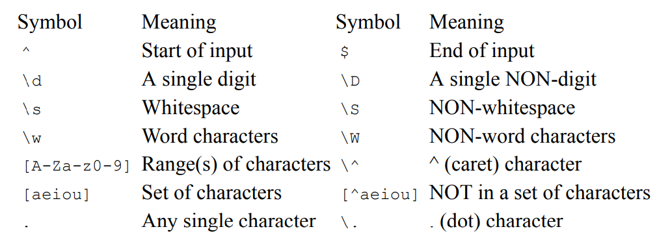
Understanding the syntax of a regular expression

Slide 28
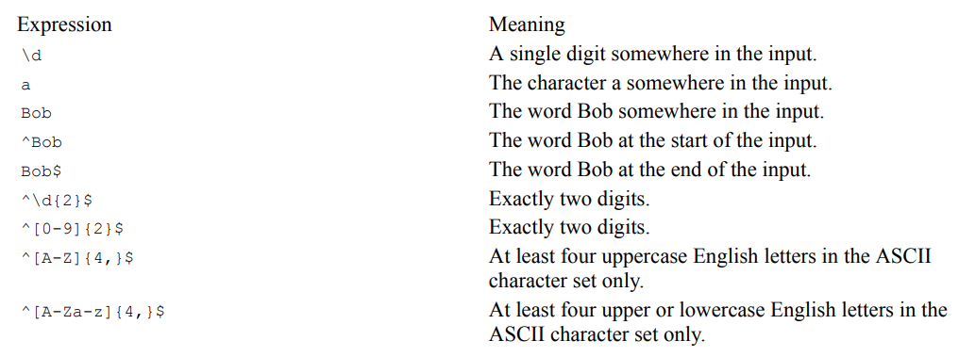
Examples of regular expressions

Slide 29
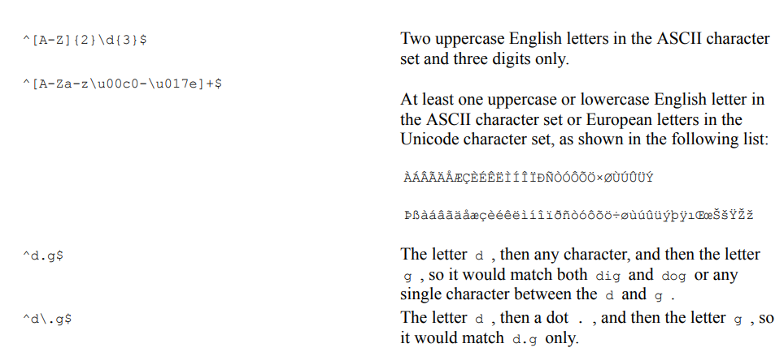

Slide 30
Spitting a complex comma-separated string
Following example of film titles
"'Monsters, Inc.','I, Tonya','Lock, Stock and Two Smoking Barrels’”
The string value uses double quotes around each film title. We can use these to identify whether we need to
split on a comma (or not). The Split method is not powerful enough, so we can use a regular expression
instead.
Sample program11:
string films = "'Monsters, Inc.','I, Tonya','Lock, Stock and Two Smoking Barrels’”;
Console.WriteLine($"Films to split: {films}");
string[] filmsDumb = films.Split(',’);
Console.WriteLine("Splitting with string.Split method:");
foreach (string film in filmsDumb)
{
Console.WriteLine(film);
}

Slide 31
Console.WriteLine("-----------------------------------------");
Regex csv = new( "(?:^|,)(?=[^\']|(\')?)\'?((?(1)[^\']*|[^,\']*))\'?(?=,|$)");
MatchCollection filmsSmart = csv.Matches(films);
Console.WriteLine("Splitting with regular expression:");
foreach (Match film in filmsSmart)
{
Console.WriteLine(film.Groups[2].Value);
}
Output
Splitting with string.Split method:
"Monsters
Inc."
"I
Tonya"
"Lock
Stock and Two Smoking Barrels"
Splitting with regular expression:
Monsters, Inc.
I, Tonya
Lock, Stock and Two Smoking Barrels

Slide 32
Working with spans, Indexes and ranges
Using memory efficiently using spans
When manipulating arrays, you will often create new copies of subsets of existing ones so that you can process just the subset. This is not efficient because duplicate objects must be created in memory.
If you need to work with a subset of an array, use a span because it is like a window into the original array. This is more efficient in terms of memory usage and improves performance. Spans only work with arrays, not collections, because the memory must be contiguous.
Before we look at spans in more detail, we need to understand some related objects: indexes and ranges.
objects in a list can be accessed by passing an integer into their indexer, as shown in the following code:
int index = 3;
Person p = people[index]; // fourth person in array
char letter = name[index]; // fourth letter in name

Slide 33
The Index value type is a more formal way of identifying a position, and supports counting from the end, as shown in the following code:
// two ways to define the same index, 3 in from the start
Index i1 = new(value: 3); // counts from the start
Index i2 = 3; // using implicit int conversion operator
// two ways to define the same index, 5 in from the end
Index i3 = new(value: 5, fromEnd: true);
Index i4 = ^5; // using the caret operator

Slide 34
Identifying ranges with the Range type
The Range value type uses Index values to indicate the start and end of its range, using its constructor, C# syntax, or its static methods, as shown in the following code:
Range r1 = new(start: new Index(3), end: new Index(7));
Range r2 = new(start: 3, end: 7); // using implicit int conversion
Range r3 = 3..7; // using C# 8.0 or later syntax
Range r4 = Range.StartAt(3); // from index 3 to last index
Range r5 = 3..; // from index 3 to last index
Range r6 = Range.EndAt(3); // from index 0 to index 3
Range r7 = ..3; // from index 0 to index 3
Extension methods have been added to string values (that internally use an array of char ), int arrays,
and spans to make ranges easier to work with. These extension methods accept a range as a parameter and return a Span<T> . This makes them very memory-efficient.

Slide 35
Using indexes, ranges, and spans
Sample program12:
string name = "Samantha Jones";
int lengthOfFirst = name.IndexOf(' ‘); // getting the lengths of the first and last names
int lengthOfLast = name.Length - lengthOfFirst - 1;
string firstName = name.Substring(// Using Substring
startIndex: 0,
length: lengthOfFirst);
string lastName = name.Substring(
startIndex: name.Length - lengthOfLast,
length: lengthOfLast);
Console.WriteLine($"First name: {firstName}, Last name: {lastName}");
ReadOnlySpan<char> nameAsSpan = name.AsSpan(); // Using spans
ReadOnlySpan<char> firstNameSpan = nameAsSpan[0..lengthOfFirst];
ReadOnlySpan<char> lastNameSpan = nameAsSpan[^lengthOfLast..^0];
Console.WriteLine("First name: {0}, Last name: {1}",
arg0: firstNameSpan.ToString(),
arg1: lastNameSpan.ToString());
Output:
First name: Samantha, Last name: Jones
First name: Samantha, Last name: Jones

Slide 36
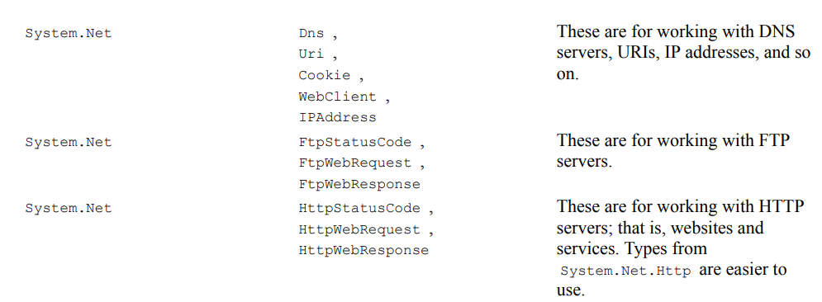
Working with network resources
Sometimes you will need to work with network resources. The most common types in .NET for working with
network resources are shown in the following table:

Slide 37
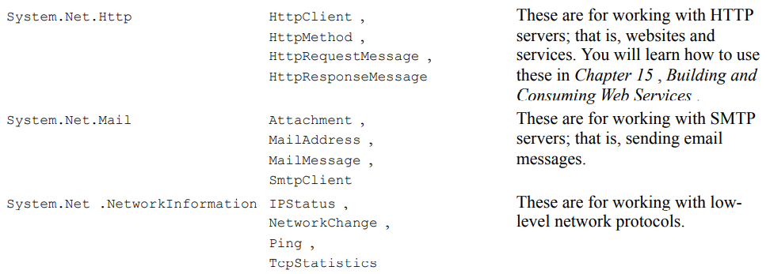

Slide 38
Working with URIs, DNS, and IP addresses
Sample program13:
Console.Write("Enter a valid web address (or press Enter): ");
string? url = Console.ReadLine();
if (string.IsNullOrWhiteSpace(url)) // if they enter nothing...
{
url = "https://stackoverflow.com/search?q=securestring"; //set a default URL
}
Uri uri = new(url);
Console.WriteLine($"URL: {url}");
Console.WriteLine($"Scheme: {uri.Scheme}");
Console.WriteLine($"Port: {uri.Port}");
Console.WriteLine($"Host: {uri.Host}");
Console.WriteLine($"Path: {uri.AbsolutePath}");
Console.WriteLine($"Query: {uri.Query}");
Output:
Enter a valid web address (or press Enter):
URL: https://stackoverflow.com/search?q=securestring
Scheme: https
Port: 443
Host: stackoverflow.com
Path: /search
Query: ?q=securestring

Slide 39
To get the IP address for the entered website
Sample program:
IPHostEntry entry = Dns.GetHostEntry(uri.Host);
WriteLine($"{entry.HostName} has the following IP addresses:");
foreach (IPAddress address in entry.AddressList)
{
WriteLine($" {address} ({address.AddressFamily})");
}
Output:
stackoverflow.com has the following IP addresses:
151.101.1.69 (InterNetwork)
151.101.65.69 (InterNetwork)
151.101.129.69 (InterNetwork)
151.101.193.69 (InterNetwork)

Slide 40
Ping a web server
Sample program:
try
{
Ping ping = new();
Console.WriteLine("Pinging server. Please wait...");
PingReply reply = ping.Send(uri.Host);
Console.WriteLine($"{uri.Host} was pinged and replied: {reply.Status}.");
if (reply.Status == IPStatus.Success)
{
Console.WriteLine("Reply from {0} took {1:N0}ms",
arg0: reply.Address,
arg1: reply.RoundtripTime);
}
}
catch (Exception ex)
{
Console.WriteLine($"{ex.GetType().ToString()} says {ex.Message}");
}
Output:
Pinging server. Please wait...
stackoverflow.com was pinged and replied: Success.
Reply from 151.101.193.69 took 9ms

Slide 41
Thank you

